Slide 1
Radiation Protection and the Safety of Radiation Sources
Student:
Abdulsamad Asuku
Tomsk Polytechnic University, Tomsk, Russia
Supervisor:
Said M. Shakour
Dzhelepov Laboratory o Nuclear Probelms
JINR, Dubna
INTERET – INTErnational Remote Student Training
Wave 7
13 June - 22 July 2022

Slide 2
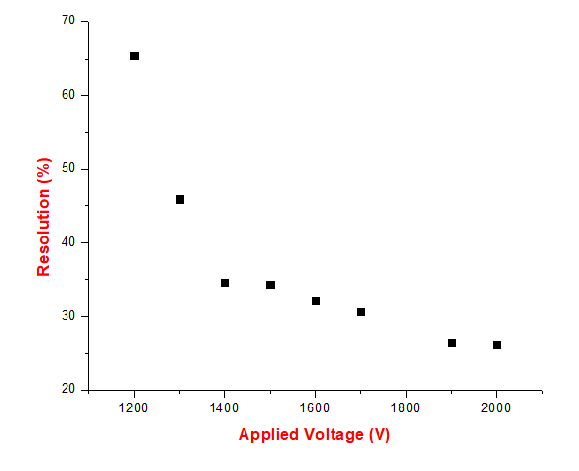
Task 1.1 Relationship between Resolution and Applied Voltage of a BGO Detector
$\left({sigma}/{mean}\right)×2$.35
No. | sigma | mean | Resolution (%) | Applied Voltage (V)
12 | 0.45302 | 1.62555 | 65.4915 | 1200
13 | 0.269192 | 1.37941 | 45.86027 | 1300
14 | 0.282574 | 1.92133 | 34.56194 | 1400
15 | 0.434947 | 2.98086 | 34.28962 | 1500
16 | 0.605286 | 4.41978 | 32.1831 | 1600
17 | 0.794874 | 6.08526 | 30.69637 | 1700
19 | 1.20299 | 10.6805 | 26.46905 | 1900
20 | 1.52027 | 13.6361 | 26.19983 | 2000

Slide 3
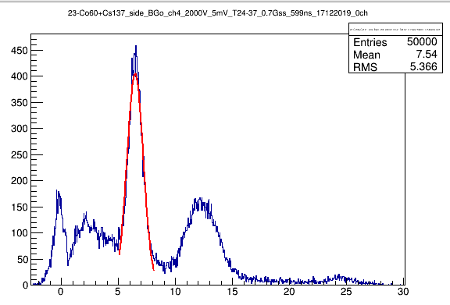
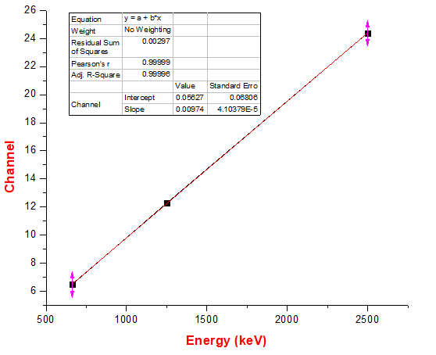
Task 1.2 Energy Calibration of a BGO Detector
Cs-137
662 keV
Co-60
1250 keV
Co-60
2500 keV

Slide 4
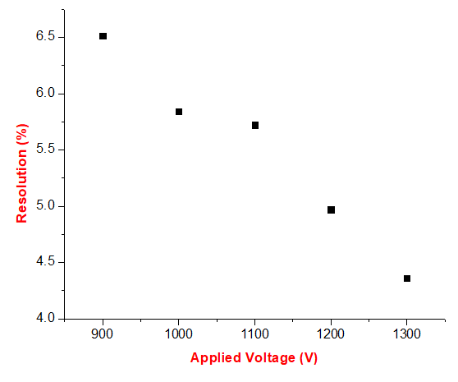
Task 2.1 Relationship between Resolution and Applied Voltage of a NaI Detector
$\left({sigma}/{mean}\right)×2$.35
No. | sigma | mean | Resolution (%) | Applied Voltage (V)
2 | 0.655425 | 23.6396 | 6.515545 | 900
3 | 1.01022 | 40.6248 | 5.843763 | 1000
4 | 1.60227 | 65.8019 | 5.722228 | 1100
5 | 2.08815 | 98.7101 | 4.971277 | 1200
6 | 2.55005 | 137.426 | 4.360614 | 1300

Slide 5
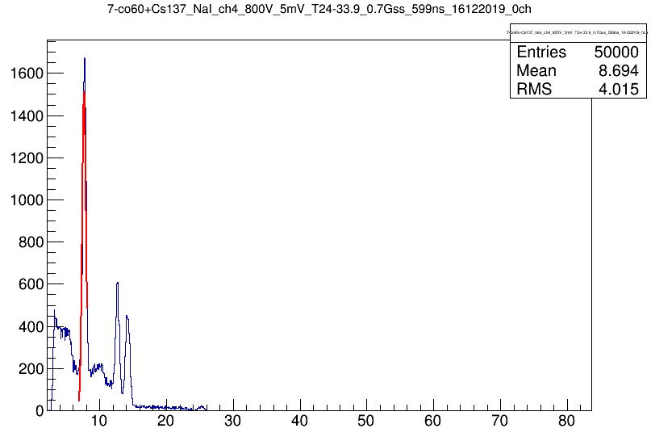
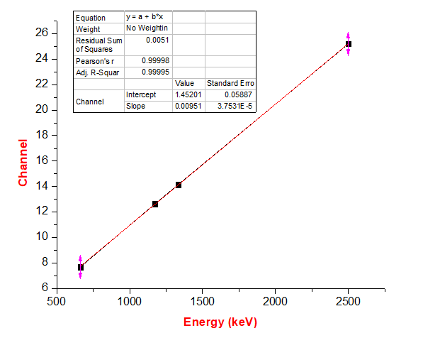
Task 2.2 Energy Calibration of a NaI Detector
Cs-137
662 keV
Co-60
1173.2 keV
Co-60
1332.5 keV
Co-60
2500 keV

Slide 6
Task 2.3 Identification of unknown sources
Procedure
The spectrum of the unknown source is obtained
A Gaus fit is made
The mean position (channel number) is found
Using the equation for the energy calibration of the detector which relates the energy to the mean position (channel number), the energy peak of the unknown source is calculated
The nuclide which has gamma energy corresponding to the calculated energy in (d) is the unknown source
$$y=mx+c$$
y= mean position
x=energy
m = slope
c = intercept

Slide 7
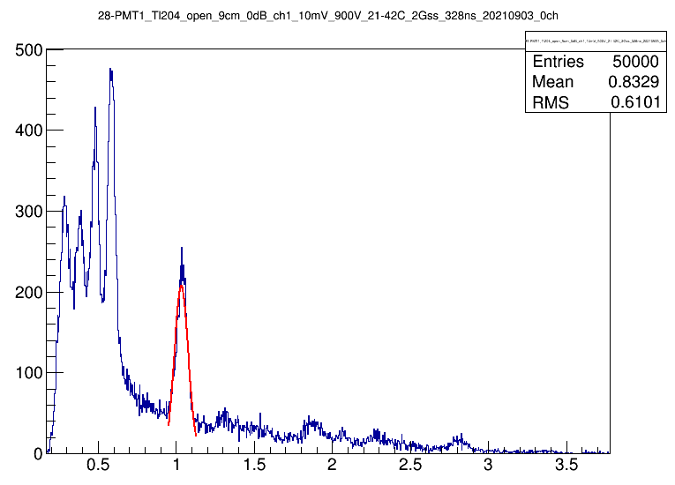
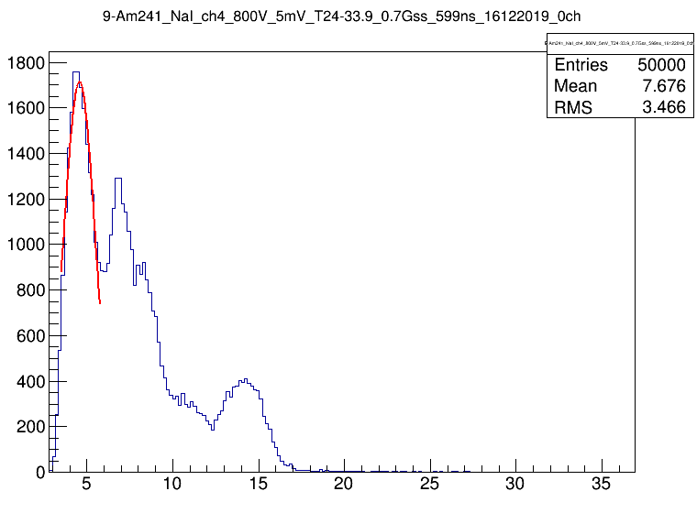
Task 2.3 Identification of unknown sources Cont.
Unknown source 1 using BGO Detector
$$y=0.00974x+0.05627$$
Y= mean position
X =energy
Mean position of unknown source = 1.03413
Hence,1.03413$=0.00974x+0.05627$
X = 100.4 keV or 0.1 MeV
Unknown source 2 using NaI Detector
$$y=0.0951x+1.45201$$
Y= mean position
X =energy
Mean position of unknown source = 4.57993
Hence, 4.57993$=0.00951x+1.45201$
X = 328.9 keV
Ir-1$9$4
328keV
Pa-234
100 keV

Slide 8
Task 3 Attenuation coefficient
Thickness, cm | I/Io
0 | 1
0.15 | 0.75573
0.3 | 0.71623
0.45 | 0.70569
0.75 | 0.68596
0.9 | 0.67155
1.08 | 0.66103
1.26 | 0.63939
Thickness, cm | I/Io
0 | 1
0.2 | 0.73931
0.25 | 0.7357
0.4 | 0.68065
0.8 | 0.58611
1 | 0.53827
1.2 | 0.48042
Al
Cu
$μ \text{= }\text{0.24}{ cm}^{−1}$
$μ \text{= }\text{0.}\text{5}\text{2}{ cm}^{−1}$

Slide 9
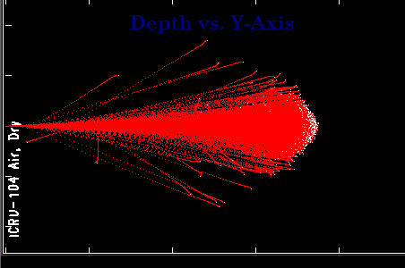
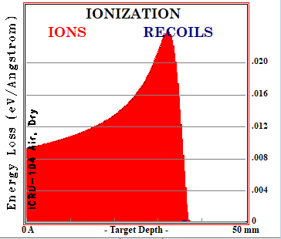
Task 4 Atpha Range in Air
Source; Pu239
Energy; 5 MeV
Detector; Plastic
Applied volt; 2000V
R$\text{= }\text{3}\text{.}\text{5 }\text{cm}$

Slide 10
Conclusion
Experience in different types of Radiation sources and detection of Radiation.
Energy calibration of some scintillation detectors by using standard sources.
Identification of unknown sources by using energy calibration curves.
Calculation of resolution of different scintillation detectors.
Determination of alpha range in air using pixel and plastic detectors.
Determination of attenuation coefficient for different materials
Assessment of the ranges and energy of alpha particles using Monte Carlo simulation SRIM software.

Slide 11
References
Cember, H., Introduction to Health Physics, 3rd Edition, McGraw-Hill, New York (2000).
Attix, .H., Introduction to Radiological Physics an Radiation Dosimetry, Wiley, New York (1986).

