Slide 1
Project: Radiation Protection and the Safety of Radiation Sources
Supervisor: Dr Said AbouElazm
Participant’s Name: Hania Azzam

Slide 2
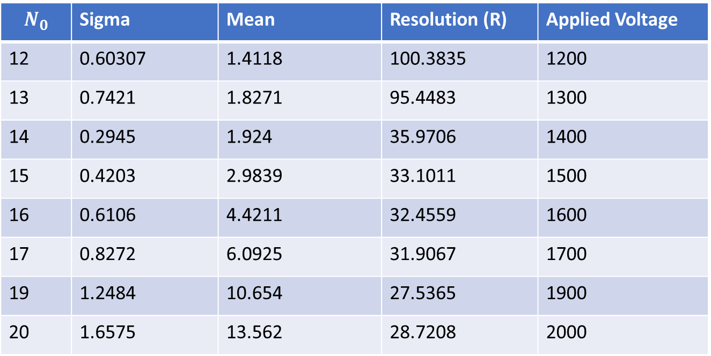

Task 1.1 The relation between the resolution and applied Voltage for BGO detector
Formula used: $R=\frac{Sigma}{Mean}×2.35$
$$N_{0}$$ | Sigma | Mean | Resolution (R) | Applied Voltage
12 | 0.60307 | 1.4118 | 100.3835 | 1200
13 | 0.7421 | 1.8271 | 95.4483 | 1300
14 | 0.2945 | 1.924 | 35.9706 | 1400
15 | 0.4203 | 2.9839 | 33.1011 | 1500
16 | 0.6106 | 4.4211 | 32.4559 | 1600
17 | 0.8272 | 6.0925 | 31.9067 | 1700
19 | 1.2484 | 10.654 | 27.5365 | 1900
20 | 1.6575 | 13.562 | 28.7208 | 2000

Slide 4
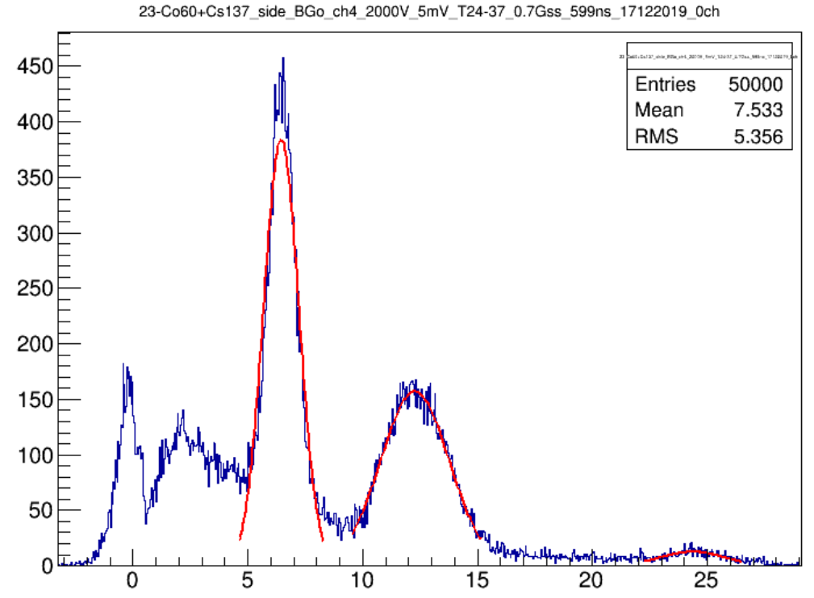
Task 1.2 Energy calibration for BGO

Slide 5
Equation of calibration: y=0.05179+9.73835x
where y = PMT signal A.U, x = Energy of unknown source

Slide 6
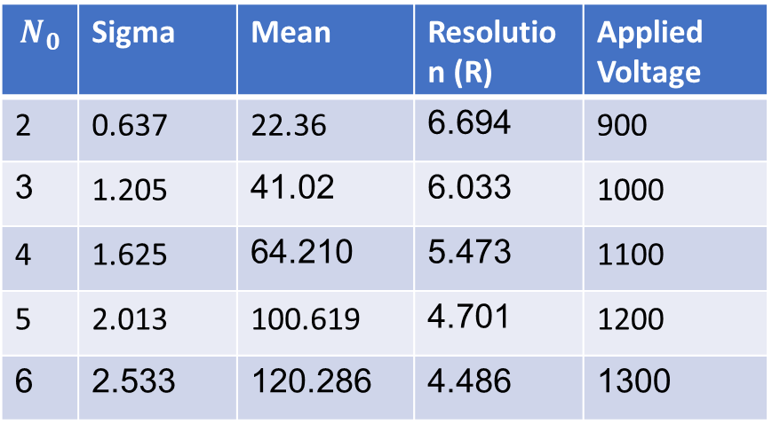

Task 2.1 . The relation between the resolution and applied Voltage for NaI detector
Equation used: $R=\frac{Sigma}{Mean}×2.35$
$$N_{0}$$ | Sigma | Mean | Resolution (R) | Applied Voltage
2 | 0.637 | 22.36 | 6.694 | 900
3 | 1.205 | 41.02 | 6.033 | 1000
4 | 1.625 | 64.210 | 5.473 | 1100
5 | 2.013 | 100.619 | 4.701 | 1200
6 | 2.533 | 120.286 | 4.486 | 1300

Slide 7
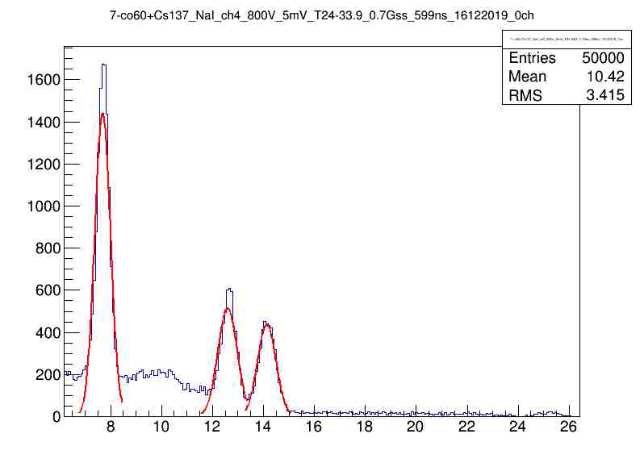
Task 2.2 Energy calibration for NaI
Equation of calibration: y= 1.45953 + 9.50263x
where y = PMT signal A.U, x = Energy of unknown source

Slide 8
Task 2.3 Identify unknown radioactive source
We get the spectrum of unknown source
We make GAUS FIT and find Mean
From energy calibration we can determine energy
peak of unknown source by using equation from
calibration of Nаl detector: y = 1.45953 + 9.50263x
where y = PMT signal A.U x = Energy of unknown source

Slide 9

Task 3 Attenuation coefficient
Attenuation coefficient describes the fraction of a beam that is absorbed or scattered per unit thickness of the absorber, $I= I_{0 }e^{−μx}$
where μ is attenuation coefficient
Determination of attenuation coefficient for Al
μ = 0.2401 ± 0.02
Determination of attenuation coefficient for Cu
μ = 0.65001 ± 0.05

Slide 10
Task 4 SRIM simulation
Depth for α-radiation in air
Ionization

Slide 11
Task 4 Alpha range in the air
Source: Pu239
Energy of He: 5.5 MeV
Detector: plastic
Applied volt: 2000 V
R = 3.5

Slide 12
Task 5 Pixel detectors (PD)
PD is an advanced detector like a digital camera;
PD has high resolution;
PD is used for registration different types of radiation
-The size of the sensor:1.5x1.5 cm;
-256 x 256 pixels (65.536 pixel);
-Pixel size: 55μm x 55μm.
It has 3 parts:
1. Sensor (Si)
2. Electronic chip
3. USB

Slide 13
Task 5
Determination the range of α-particles with (Am-241) energy about 4 MeVin air using pixel detector.
2.5 MeV
4 MeV
Absorption of alpha particle energy in the air at 0 cm
Absorption of alpha particle energy in the air at 1 cm

Slide 14
Task 5
1.7 MeV
0.5 MeV
Absorption of alpha particle energy in the air at 2 cm
Absorption of alpha particle energy in the air at 2.5 cm

Slide 15
Task 5
Determination the range of α-particles with (Am-241) energy about 4 MeVin air using pixel detector.
There are no α-particles at 3 cm distance
Maximum of α-particle range is 3 cm
Maximum range of α-particles in air (3 cm)

